Slide 1
UE18CS390A – Capstone Project Phase – 1
SEMESTER - VI
END SEMESTER ASSESSMENT
Project Title : Video Summarization of Sports Games
Project ID : PW22SSS05
Project Guide : Dr.Shylaja S S
Project Team :
Bhavana Madhuri V - PES120181231
Eshwar PK - PES120181487
Jayanarayanan - PES120181220
Rohan Bennur - PES120181718

Slide 2
Outline
Problem Statement
Abstract and Scope
Literature Survey
Design Approach
Design Constraints, Assumptions & Dependencies
Proposed Methodology / Approach
Architecture
Design Description
Technologies Used
Walkthrough
Summary of work done in Capstone Phase-1
Project plan for Capstone Phase-2
References

Slide 3
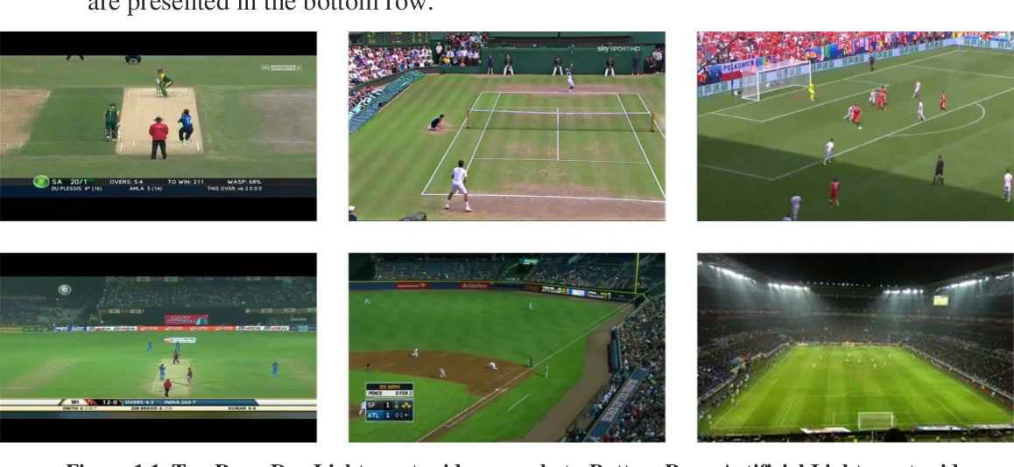
Problem Statement
There is a rapid rise in video content, especially in the sports field, with an enormous collection of sports games, which go on for a couple of hours to as long as days, being uploaded to the internet every single day.

Slide 4
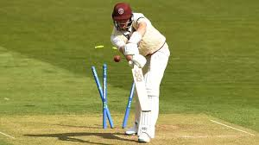
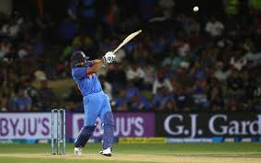
Most of these full sized sports games aren’t watched by a lot of people because of how long they are, and how much time it would take for them to watch it from start to end. More people want to watch highlights of sports games.
Although video editors are responsible for making most of the sports highlights videos these days, more companies want software that could do this for them, with the same level of accuracy and efficiency, as it would be cheaper for them in the long run. Hence, the need for automatic sports video summarisation is high, now more than ever.
Notes:
It’s no surprise that the percentage of people who watch recorded versions of entire sports games keeps decreasing, while the percentage of people who watch highlights of those sports games keeps increasing.

Slide 5
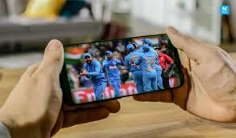
Abstract and Scope
There is no denying the crucial role that highlight videos can play for many student-athletes in their recruiting process, or a busy person who just wants to view the gist of a particular match.
In order to solve this problem, this work proposes a novel video summarization method that uses a combination of the commentators’ speech and the crowd cheering noise as cues to determine the highlights of the original video. A deep neural network-based approach is used to classify video segments into interesting or uninteresting events, and the interesting events are put together to obtain a summarized highlights video of the sports game.
Notes:
Instead of spending hours on watching the full recording of a game, watching highlights would make that person’s life much easier.

Slide 6
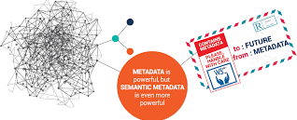

Literature Survey
“Video summarization for large sports video archives” - [Yoshimasa
Takahashi, Naoko Nitta, and Noboru Babaguchi ]
This paper focuses on metadata which includes
semantic information of the video.
Two methods are proposed; create a video clip and
provide a video poster. Significance degree of a play
scene is computed by calculating and combining degrees
of components such as play ranks (α - coefficient to consider
effect on significance based on difference in ranks), play occurrence time (β - based on the occurrence time) and number of replays (γ - based on the number of replays).
Z-score was used to minimize difficulty to compare significance of play scenes in different videos while tackling more than one video.
Notes:
Play ranks - Significance degree of play scenes
Play occurrence time - Occurrence-time-based significance degree of a play scene
Number of replays - Number-of-replays-based significance degree of a play scene

Slide 7
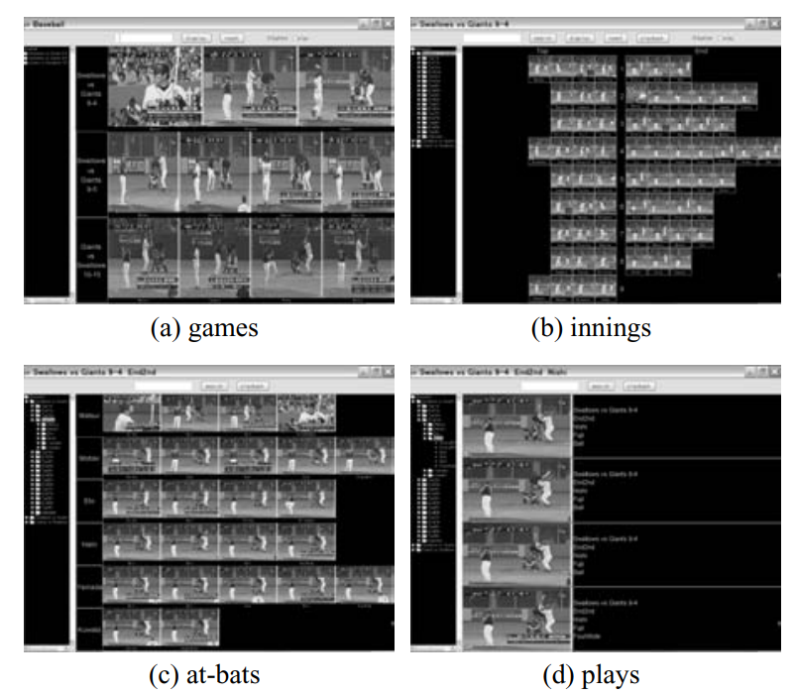
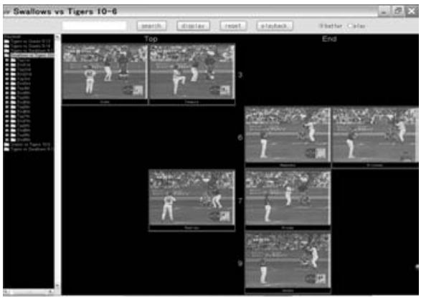
VISUALIZATION
Video Poster
(a) Shows key frames of important scenes
(b) Each row represents an inning
(c) Each row represents an at-bat.
(d) Plays are lined up from top to bottom in the temporal order
Display of highlights:
User can directly specify number of keyframes to be displayed.
Notes:
Visualization : Video clip - time length of the original video is temporarily compressed.

Slide 8
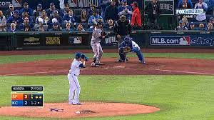
EXPERIMENT
An experiment was conducted based on the proposed methods
on 5 baseball videos broadcasted by three different TV
stations.
The summaries generated were compared with the highlights
broadcasted taking it as a correct answer set. Results were
generated with the recall and precision rates. Value of the
parameters, α, β, γ, were experimentally determined.
CONCLUSION
Significant play scenes with recall rate of 66% and precision rate of 83% compared with the summaries broadcasted on TV was obtained when experimented with baseball videos. It was therefore concluded that, this system only serves for baseball videos. To use this system for other sports, a standard way to determine the values of the parameters should be formulated and values of the parameters should be changed based on the type of sport. Hence, personalization in making video summaries was not considered to meet users’ preferences.
Notes:
Recall (number of the play scenes included in both TV and summary / the number of the play scenes included in the TV summary) × 100)
Precision (number of the play scenes included in both TV and our summary / the number of the play scenes included in summary) × 100).

Slide 9
2. “Summarization of User-Generated Sports Video by Using Deep Action Recognition Features” - [Antonio Tejero-de-Pablos, Member, IEEE, Yuta Nakashima, Member, IEEE, Tomokazu Sato, Member, IEEE, Naokazu Yokoya, Life Senior Member, IEEE, Marko Linna, and Esa Rahtu]
In this paper, the authors propose a method to generate video highlights for UGSV dataset. In most cases, user-generated sports videos (UGSVs) are often lengthy with several uninteresting parts, and thus many of them are stored and are never reviewed. A convenient way to review, transfer, and share the video via channels, such as social network services, includes generating summaries of a UGSV that only shows the interesting parts or highlights. The observation concerning semantics extraction is that a game in most sports consists of a succession of players’ actions, and thus the actions can be one of the most important cues to determine if a certain part of the video is interesting or not. ex a definitive smash in tennis is more likely to be enjoyed by tennis viewers than a repetitive ball exchange

Slide 10
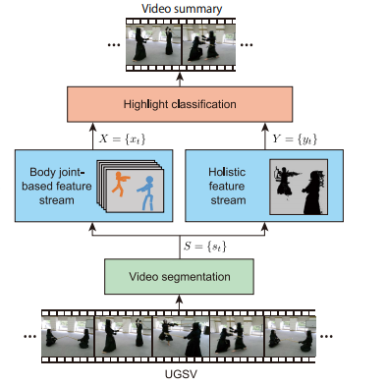
Methodology
The proposed method uses a two-stream architecture that extracts two types of action features for action representation.
One type involves players’ body joint positions estimated in 2D or 3D (obtainable from depth maps). Body joint-based features provide a precise representation of actions.
The other type involves holistic features that can be obtained with deep convolutional neural networks (CNNs) designed to extract Spatio-temporal features from video. Holistic features help to capture actions in their context.
Subsequently, long short-term memory (LSTM) is used to model the temporal dependencies of the extracted features for highlight classification.
Notes:
An overview of the proposed method to generate a summary of user-generated sports video (UGSV) based on players’ actions. Two types of features that represent players’ actions, namely body joint-based and holistic actions, are extracted in the preprocessing stages and fed into the machine learning models for highlights generation.

Slide 11
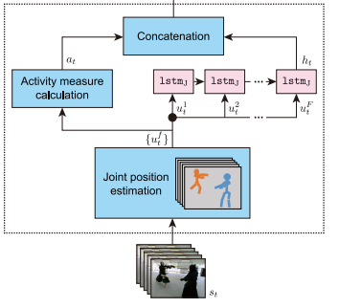
In the body joint-based feature stream, an LSTM is fed with the body joint positions estimated from players on each frame u f t to model temporal dependencies and extract a feature vector ht. Additionally, these body joint positions are also used to calculate an activity measure for all players at. The body joint-based feature vector is their concatenation xt.

Slide 12
Strengths
The proposed model not only takes into consideration, the body-joint positions but also the holistic features. The body-joint positions provide rich information on players’ actions but miss other potential cues for summarization contained in the scene. Holistic features can compensate for such missing cues by, for example, modeling the context of an action. Also, holistic features are useful when the joint position estimation fails.
Weaknesses
The model proposed in this paper requires that the videos are recorded from a close distance whereas this is not the case in most user-generated sports videos.
The estimation of frame length is a major concern as shorter frames can increase the computation and even not capture the semantics of action completely. On the other side longer frames generally lead to reduced accuracy

Slide 13
3. “Sports highlights generation based on acoustic events detection: A rugby case study” - [Anant Baijal, Jaeyoun Cho, Woojung Lee and Byeong-Seob Ko]
The field of sports highlights generation is extensively researched. Prior studies have used audio cues,visual cues, mixture of audio and visual cues as features to generate highlights. In this paper the authors have used audio data for content recognition and highlights generation.
Methodology
Based on audio contents of rugby matches,
Referees whistle,commentators speech and crowd noise can be used as features.

Slide 14
Benefits
As the authors have used audio data as the feature for highlight generation , the load on processing and computation is lighter when compared to other methods. The accuracy of correct classifications are also high when compared to other methods.
Drawbacks
There is an overlap of other sounds like crowd noise, music noise or ad breaks played in the stadiums with key acoustic sounds, hence it becomes challenging for the classifier to categorize the events correctly

Slide 15
4. “Video Summarization-Sports Highlights Generation”
[Muhammad Ehsan Anjum, Syed Farooq Ali, Malik Tahir Hassan, Muhammad Adnan]
In this paper, the authors propose an interesting approach to video summarization of sports games.
The score bar is extracted from the frames, which provides accurate results for highlighting key events. This score bar is usually present in the bottom part of the broadcast/frames.
Once the score is captured from a frame, a character recognition model is used to extract the text of the score area.
Once this is obtained, it is compared with the previous captured frame, and if the difference in the scores obtained from these 2 frames is 4 or 6, or if the wicket digit increases by 1, then it classifies the current frame as a significant event.
After we capture all such significant events, a short video summary is synthesized that includes the frames for the aforementioned significant events termed as Highlights.

Slide 16
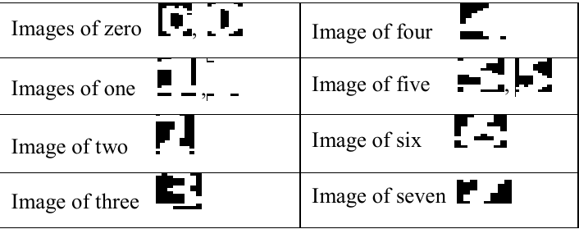
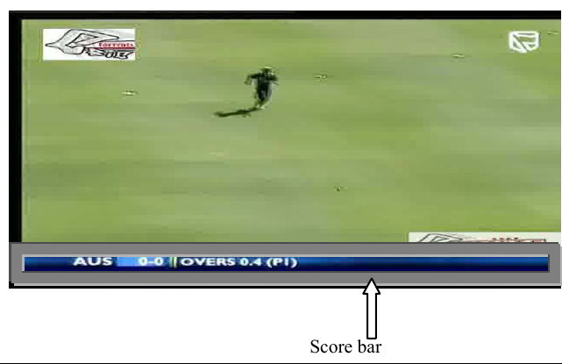

Figure 3
Figure 1
Figure 2

Slide 17
Strengths:
The complexity of code, time taken to complete the task, and the load on the computer is less when compared to other methods.
Provides more accurate classifications.
Weaknesses:
It’s main weakness is that the accuracy of correct classifications reduces as you increase the frame gap, but keeping the frame gap too low can increase the load on the computer and the time taken to classify key events.
Conclusion:
Using this method is fairly simple to implement, and is pretty accurate when done right. As long as the OCR(Optical Character Recognition) software is accurate, the efficiency and accuracy of the ML model will be high. But as this is fairly simple to implement, and finding the start frame and the end frame is difficult, we will be proceeding with the method of using acoustic features to classify key events.

Slide 18
5. “Automatic Cricket Highlight generation using Event-Driven and Excitement-Based features” - [Pushkar Shukla, Hemant Sadana, Apaar Bansal, Deepak Verma, Carlos Elmadjian, Balasubramanian Raman, Matthew Turk]
In this paper, a machine learning model was proposed which has an ability of automatically producing sports highlights of cricket videos. To take into consideration both event-based and excitement-based features, a model was proposed to identify and capture important events in a cricket match series . Some examples used to identify such events include, replays, audio intensity and player celebration.
STRENGTHS
Manual highlight generation however, calls for professional editing skills and is a tedious process. This also restrains the amount of media that can be summarized on short notice. For example, this work proposes an approach for automatic highlighting for 4 hours and the long for 6 days.
Automatic highlight generation can be one of the two, that is, event-driven — where certain rules of the game are taken into consideration — or excitement-based — where gestures from players, crowd movement and commentators’ speech are used for drawing out highlights. Event-driven features are used for identifying the four major events in a cricket match, wickets, boundaries, sixes and milestone.

Slide 19
METHODOLOGY
Video shot detection is a virtual feature of sports video summarization. A thorough cricket match can be divided into a sequence of video shots, which is basically a chain of frames that are part of the same camera take. Therefore, events in a cricket match can be viewed as a sequence of video shots.
REPLAY DETECTION
Replays bring forth crucial cues for major events as they are regularly used in cricket game highlights.
The cropped image is then utilized for allocating a video shot as either an ongoing event of the game or as a replay/advertisement using a Convolutional Neural Network (CNN) + Support Vector Machine (SVM) framework.

Slide 20
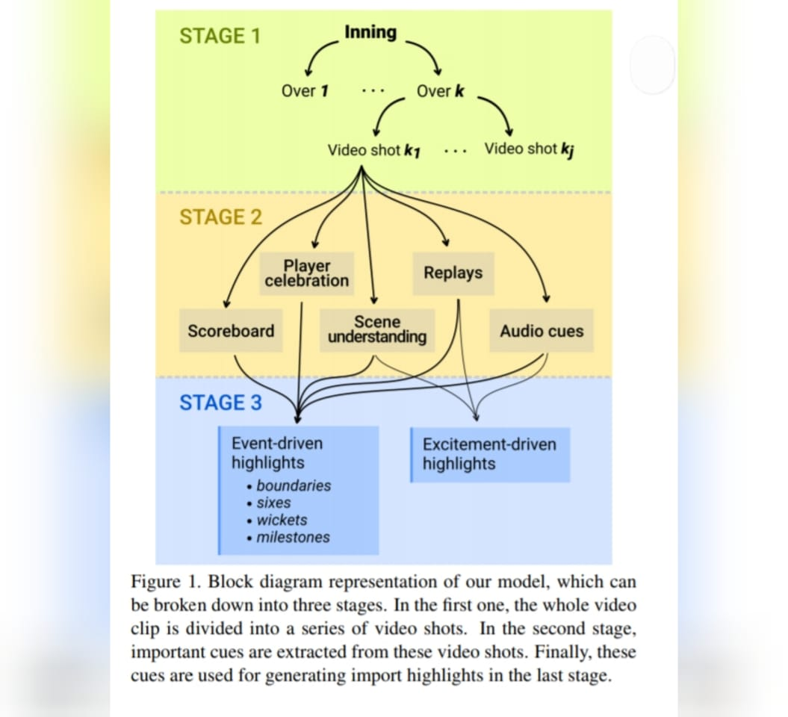

Slide 21
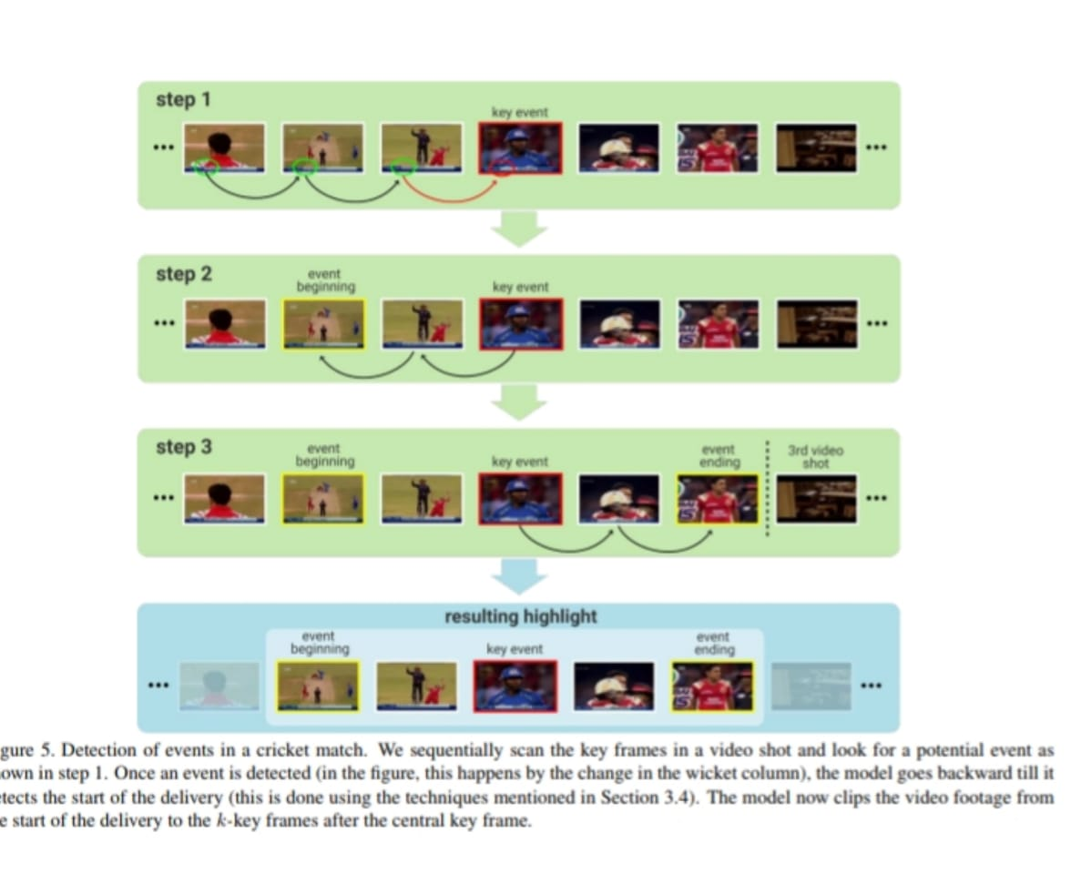

Slide 22
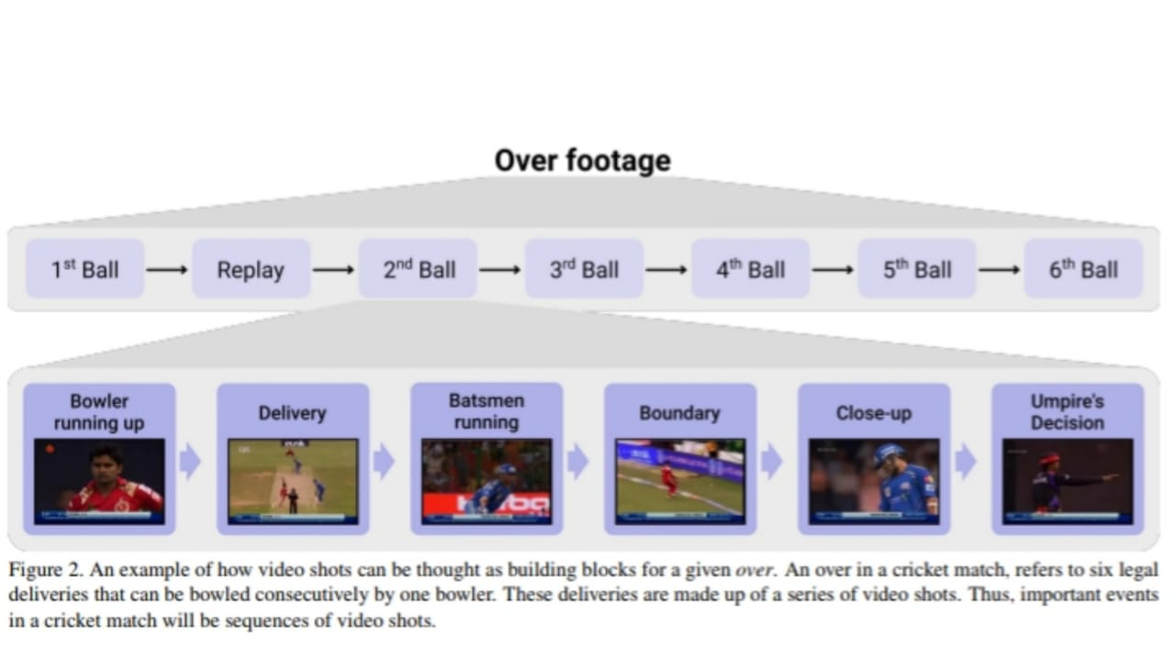

Slide 23
Design Approach
We plan to approach the challenging problem of generating highlights from sports broadcasts by utilizing audio information. A language-independent, multi-stage classification approach will be employed to detect key acoustic events which then act as a platform for summarization of highlight scenes.
Benefits
Computationally less expensive as compared to other methods.
Higher accuracy of correct classifications as compared to other methods.
Drawbacks
Audio data that is used for content analysis may be corrupted from random noises like advertisements or music played in the stadium.

Slide 24
Design Constraints, Assumptions & Dependencies
Design constraints and assumptions made to select the design approach.
As the video files are huge, uploading them to the server is one of the constraints. We have made an assumption that the user will have a high speed network connection.
As the video files are huge, the server has to read through the entire video, perform the classifications and render the summarised video, which will require high computation power. We have assumed that the server machine has powerful components to perform such heavy tasks.
We have also made an assumption that the user will have the entire sports video with him/her that he/she can upload.
Dependencies that the design approach has and its impact on the project.
The user does not need to have any extra hardware other than a phone or a PC that is connected to the internet.

Slide 25
Proposed Methodology / Approach
Audio is a very important ingredient of any audio visual media. It is that one ingredient that brings the entire content to life; otherwise it would just be a motion of images.
Looking exclusively at sports, content is generously interspersed with commentary—it’s a way to provide otherwise inaccessible information to viewers in a timely manner, enhancing their viewing experience. Viewers are generally interested in knowing important information not covered by the live camera angle, such as how the injured player is recovering, and whether the crowd is friendly or not. There are many things commentators can see and tell the audience besides sharing interesting facts and trivia in order to make experiences more memorable..
These commentators speech also becomes excited during an interesting scene which shows that there is a strong correlation between interesting scene and commentators speech
The crowd also goes wild during an interesting scene leading to increased audio levels which will also be used as a feature.

Slide 26
Methodology
In this approach audio is extracted from a sports video that has to be summarised. Then from the extracted audio file, MFCC features are extracted using the librosa python library.
The extracted MFCC features are then normalised and fed into the designed Deep Neural Network models.
In the first step the input data is classified as speech or non speech data
  If the data was classified as speech data, the input file will later be fed into another DNN model which classifies the data as interesting or not interesting based on the commentators speech.
  If the data was classified as non-speech data, the data will be fed into another DNN which classifies the data as interesting or not depending on the intensity of the crowd noise.
Notes:
The MFCC feature extraction technique basically includes windowing the signal, applying the DFT, taking the log of the magnitude, and then warping the frequencies on a Mel scale, followed by applying the inverse DCT

Slide 27
Benefits
The major benefits of using audio data is that they are computationally less expensive and provide higher accuracy when compared to other viable methods for Video Summarization.
Drawbacks
The biggest challenge during commentary is clear audio. This is the stage where different noises such as background and echo can be introduced into the content. The scene of action is generally an outdoor area. Weather, wind, cheers from the audience and many other subtle factors can also allow various noises to creep into the content
Audio/Video Synchronization
  Synchronization is one of the most important aspects of the viewer experience.
  Sync loss could be caused by the mixing/editing process, mic position or even signal processing delays between the mic and camera.

Slide 28
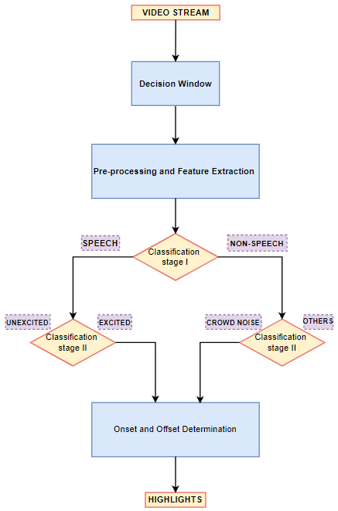
Architecture
Trained model first identifies the incoming acoustic events as either ‘speech’ or ‘non-speech’ which are then classified as, if ‘speech’, to ‘excited’ and ‘unexcited’ and ‘crowd noise’ if ‘non-speech’.
The onset and offset are determined through a decision window.
If the decision window exceeds a set threshold, the starting point of the decision window becomes the onset of the highlight scene.
The decision window’s starting point is continuously shifted until it meets the percentage threshold that was set. This end point of the highlight scene is then fixed as the previous decision window’s endpoint.
25

Slide 29
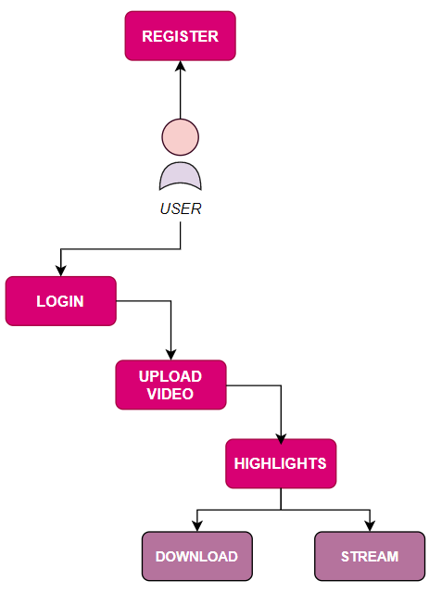
Design Description
1. User Interface Diagram
In this approach,
The user is required to first register and then login with the registered details.
User then uploads a video from which highlights need to be extracted.
After the generation of highlights, the user is given an option to either just stream the generated highlights, or download then generated highlights.

Slide 30
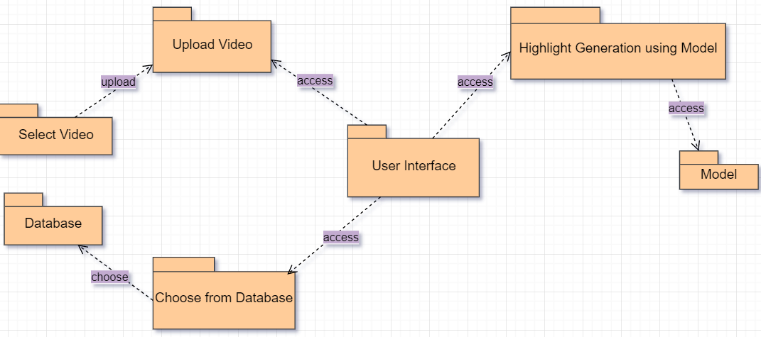
2. Package Diagram
In this approach, the user is directed to a local storage for uploading a video if the ‘upload video’ button is selected. The user can also choose from a given dataset gathered by the team in the database. The model then generates the highlighted scenes from the video provided by the user. After the highlights have been generated, the user can either choose to just stream the highlights or download the highlights.

Slide 31
Walkthrough
Implementation and Pseudocode
Initially Moviepy module of python is installed which is majorly used for editing videos using python. FFmpeg is a multimedia framework used for handling audio, video and other streams.
After installing, the librosa library was imported and the audio data was extracted from the videos and a new mp3 format was saved to google drive.

Slide 32
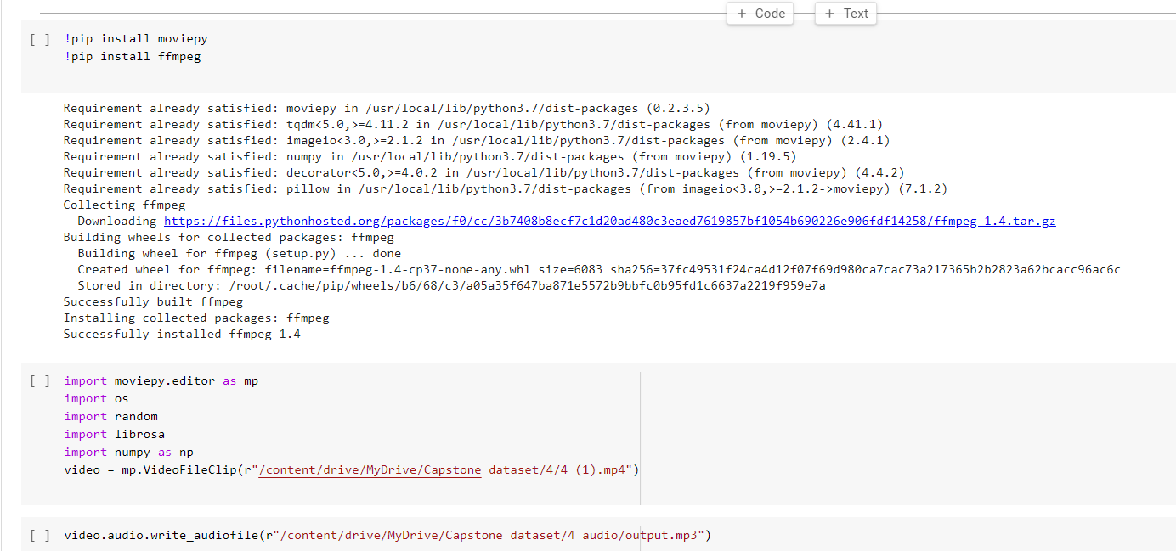
The following code has been written as part of initial implementation.

Slide 33
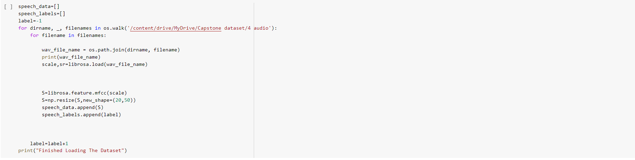
Using the newly stored mp3 audio file librosa was used in extracting MFCC features.Since the length of videos in the dataset vary , the shape of the MFCC features for each audio file also varied. Hence all the MFCC features are then resized to a constant shape of (20,50). The MFCC features that were extracted are then stored in a speech_data array.
These extracted features are to be normalised and then used as an input to CNN+RNN DNN model .

Slide 34

Project Demo
Unsummarized video:

Slide 35
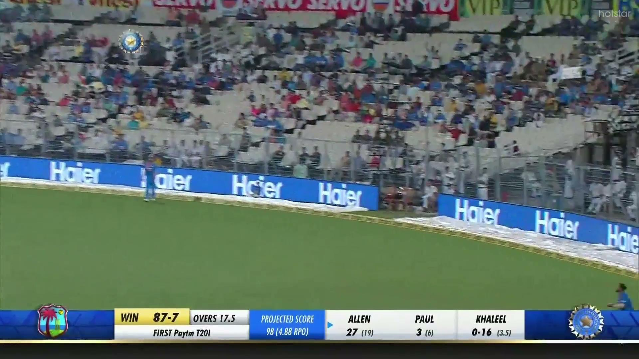
Project Demo
Summarized video:

Slide 36



Technologies Used
We plan to use any of the Linux Distributions as the OS for our server because of its stability, reliability and security.
We are using python as our chosen language to program the machine learning model because of the extensive selection of libraries available.
Some of the packages we’re using is the Librosa package for music and audio analysis, TensorFlow for machine learning, and NumPy for working with arrays and other high level mathematical functions.

Slide 37



For the server machine, we plan on using high performance CPU(Intel i7 8750H) and GPU(NVidia GeForce GTX 1070). We also plan on using a high memory RAM(16GB DDR4 Memory).
HTML, CSS and JavaScript are our chosen languages for the front end development of the web application.
We intend to use Node JS for the back end development of our web application, and MongoDB as our Database.

Slide 38
Summary of work done in Capstone Phase-1
In this phase, we have surveyed 5 papers and written summaries for each of the papers.
We have also created a document which collectively compasses and summarises all the 5 papers.
We have concluded that using the acoustic event detection method is the best method for summarising sports games like cricket.
As we couldn’t find datasets for our project, we have built a majority of our dataset on our own.
We have written pseudo-code for some parts of our project.
At the end of this phase, we have finished 50% of our entire project work.

Slide 39
Project Plan for Capstone Phase-2
We aim to deliver the following for the second phase of our capstone project:
Complete building the training data and test data for our dataset.
Design a neural network based machine learning model that classifies important/key events and unimportant events.
Improve the accuracy and efficiency of the machine learning model as much as possible.
Make a simple/minimal yet fully functional user interface in the form of a web application.
Document the entire process and develop a well-written report for our capstone project.

Slide 40
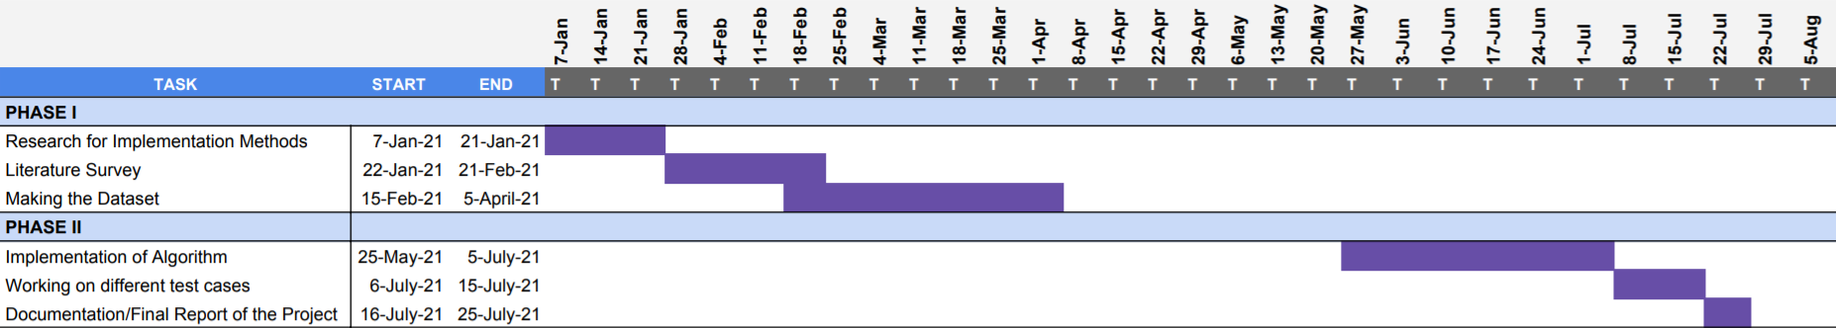
Timeline of Phase-1
Summary of Phase-1 of Capstone project and forethought of Phase-2 of Capstone project is shown in the form of a gantt chart.

Slide 41
References
Y. Takahashi, N. Nitta, and N. Babaguchi, “Automatic Video Summarization of Sports Videos Using Metadata” Proc. IEEE PCM 2004, Vol.2, pp.272-280, December, 2004
Antonio Tejero-de-Pablos, Yuta Nakashima, Tomokazu Sato, Naokazu Yokoya, Marko Linna, and Esa Rahtu, “Summarization of User-Generated Sports Video by Using Deep Action Recognition Features”
Muhammad Ehsan Anjum, Syed Farooq Ali, Malik Tahir Hassan, Muhammad Adnan, “Video Summarization-Sports Highlights Generation”
Pushkar Shukla, Hemant Sadana, Apaar Bansal, Deepak Verma, Carlos Elmadjian, Balasubramanian Raman, Matthew Turk, “Automatic Cricket Highlight generation using Event-Driven and Excitement-Based features”
Anant Baijal, Jaeyoun Cho, Woojung Lee and Byeong-Seob Ko, “Sports highlights generation based on acoustic events detection: A rugby case study”

Slide 42
Thank You

